Slide 1

Patch Management Process & Challenges - IDC
Presented By : Mr. Umesh Bonde
IDC
IDC - Planning, Engineering & Implementation

Slide 2
Agenda
Current Patch Management Architecture – at IDC
Understanding the Current Patching Process – at IDC
IDC Systems - Inventory
Challenges Faced – For Implementation / Post Implementation
Way Forward – HP SA Deployment
IDC

Slide 3
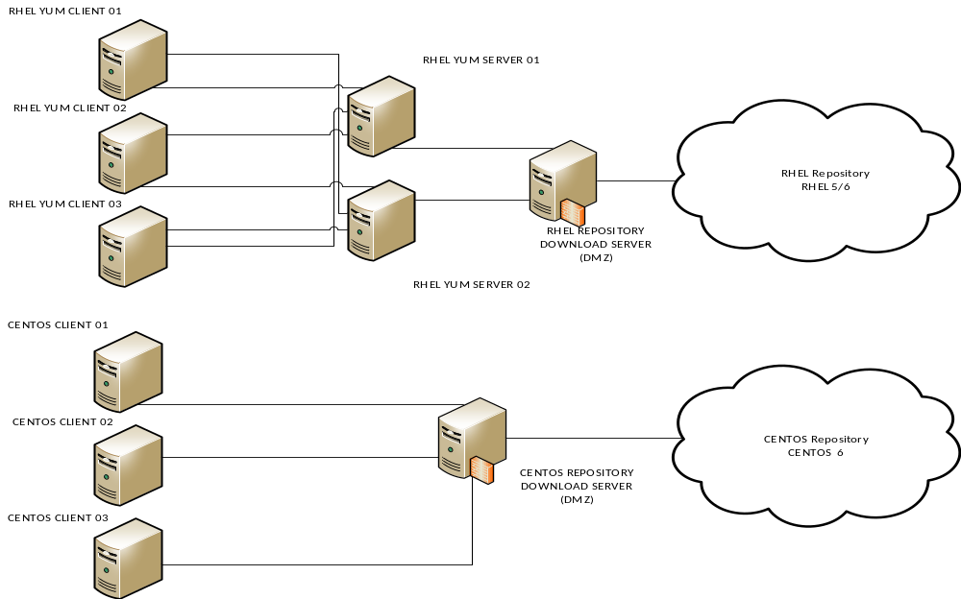
Current Patch Management Architecture – at IDC
IDC

Slide 4
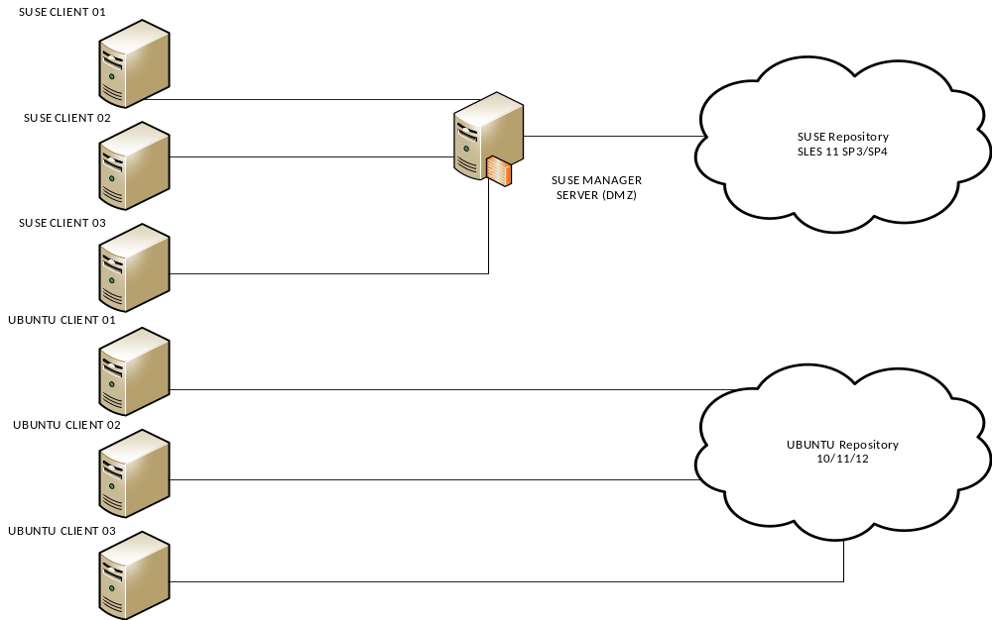
Current Patch Management Architecture – at IDC Contd..
IDC

Slide 5
Understanding the Current Patching Process – at IDC
Currently Patch Management for the servers hosted in IDC is done using the following process and tools:
WSUS - for Microsoft Windows patches
SATELLITE / YUM Server for RHEL patches
SPACEWALK for CentOS patches
SUSE Manager for SUSE patch management
UBUNTU Online Repository for Ubuntu patch management
Respective Linux patch sets are downloaded from their official patch sites and centrally stored in local repository library centrally. These are then distributed to the various respective clients.
IDC

Slide 6
IDC Systems - Inventory
Operating Systems (All versions) | No of Servers (PROD + DEV)
MICROSOFT WINDOWS | 3305
RED HAT LINUX | 1019
CENT OS | 176
SUSE LINUX | 30
UBUNTU LINUX | 28
IDC

Slide 7
Challenges faced in Patch Management (PM)
Following are the challenges that IDC / SAP faces during the PM process:
Lack of Skilled / Technical resource for patch management.
Approved Maintenance window for the activity – First from business, then from Infra owners.
Downtime given only in off peak hours which is a short duration to troubleshoot any issues (if occur).
Checking the dependency of the patches with the Third party softwares like SAP / EMC / Veritas etc.
Delays in patch release, downloads & unpredictable downtime faced due to installations of unknown patches.
Multiple reboot are required for Microsoft Windows.
More than 2 hours time required for patch installation on Microsoft Windows.
Product upgrade getting pushed in windows patches (Like IE, Dot Net) creating issues.
In RHEL / CentOS Linux patch management, the OS kernel gets updated to latest, which is not acceptable by application owner.
Non availability of central patch monitoring & reporting tool.
IDC

Slide 8
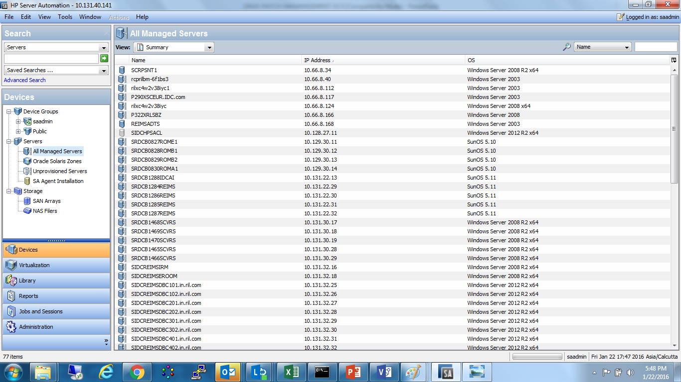
Way Forward – HP SA Deployment
We are looking at deploying the HP Server Automation Tool which will help to centrally manage the patch management process and provide appropriate reporting of the status.
IDC

Slide 9
Way Forward – HP Server Automation Contd..
Following are the listed advantages that we will observe using this tool:
Heterogeneous patch management from a single console.
Comprehensive and customizable compliance management.
Server configuration management made easy.
Security Compliance reporting.
Customer example 1
Reduced time to provision a full stack server from operating system to patches and applications from two days to 60 minutes.
Customer example 2
Reduced security patch deployment for Microsoft Windows patches from two days to three minutes.
IDC

